Slide 1
LECTURE 8

Slide 2
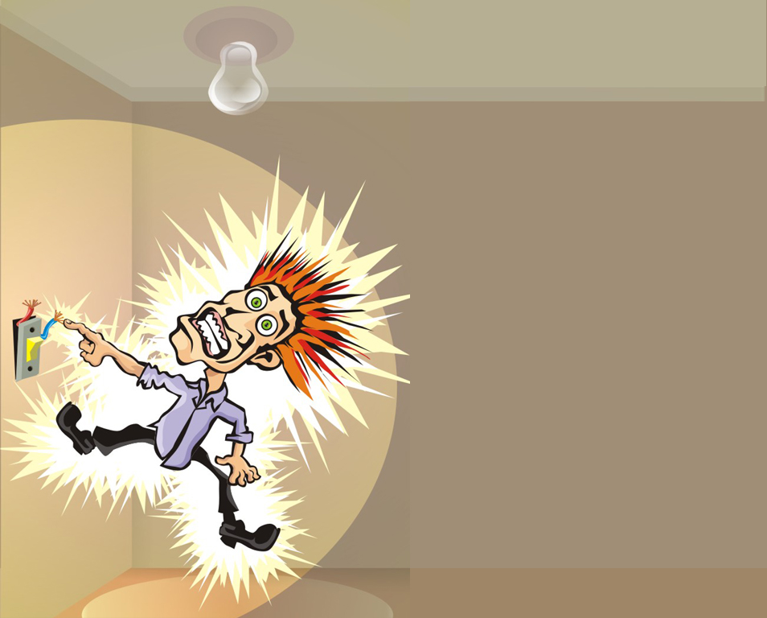

Slide 3

Effects Of Electric Current
1st
Effect
Heating
Heating
2nd
Effect
Magnetic
3rd
Effect
Chemical

Slide 4
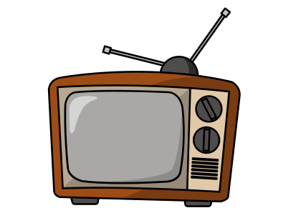
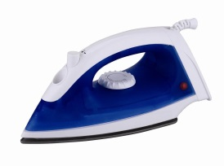

Heating Effect of Electric Current
Atoms in the state of vibration
Kinetic energy
Free electrons in the state of random motion
Collisions
+
-
Loss in kinetic energy
But, according to law of conservation of energy, energy cannot be destroyed hence, this loss in kinetic energy is converted into heat energy
Heat energy

Slide 5
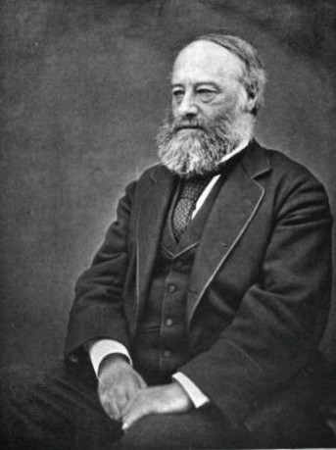
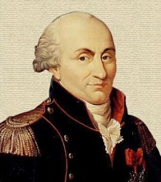
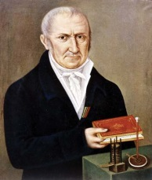
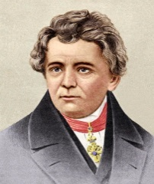
JOULE’S LAW
Heat produced in a resistor is directly proportional to
Q
Substituting eq (i) and (ii) in eq (iii), we get
I
t
+
-
Square of the current (I²)
W = IR.It
Resistance of the conductor (R) and
R
Time for which the current flows (t)
∴ W = I²Rt
joule
Q
I
I =
Acc. To COULOMB
∴ H = I²Rt joule
+
-
Acc. To VOLT
V
t
Q
W
∴Q = It
(i)
I =
V =
Ohm’s Law
W
t
Q
∴V = IR
(ii)
V = IR
Q
+
-
W
V =
∴W = VQ
(iii)
Q
JOULE
V

Slide 6
BRAIN TEASER
1. Which out of these is the right answer for Joule’s law ?
(b)
(c) (d)
Q V = IR
∴ H =
∴ H =
Q V = IR
∴ H =
∴ H =
I²Rt
H =
J
4.18
VIt
V²t
H =
J
H =
J
4.18
4.18
Vt
H =
J
4.18R

Slide 7
BRAIN TEASER
1. Which out of these is the right answer for Joule’s law ?
Vt
(a)
H =
VIt
J
(b)
H =
J
R
Q V = IR
∴ H =
∴ H =
J
IR x It
V²t
(c)
H =
I²Rt
J
(d)
H =
J
R
Q V = IR
∴ H =
∴ H =
J
I²Rt
I²R² x t
J
R
I²Rt
J

Slide 8
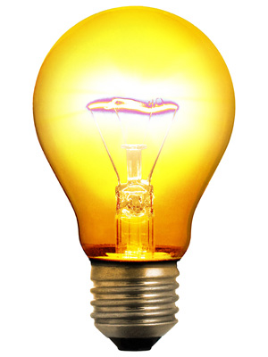
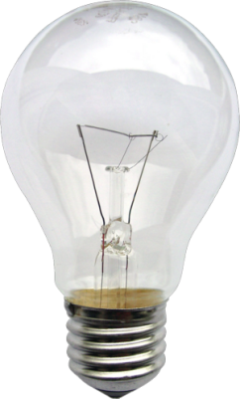
APPLICATIONS OF HEATING EFFECT
OF ELECTRIC CURRENT
ELECTRIC BULB
Filament made of tungsten
1
High Resistance
2
High Melting Point
3380⁰C
Chemically inactive nitrogen & argon
To Prevent oxidation

Slide 9
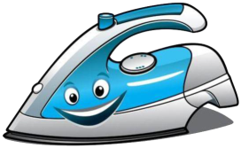

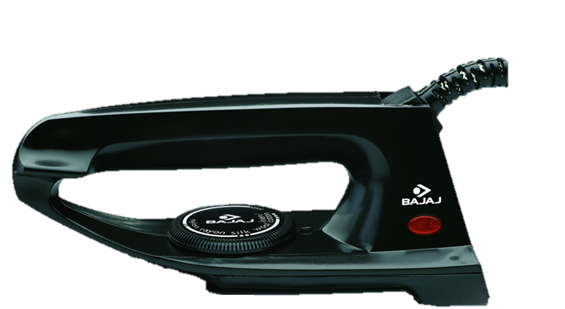
ELECTRIC IRON
It is bad conductor of electricity and good conductor of heat
When electric current passes through the coil it gets heated
Insulated mica sheet
Covered by
Coil of high resistance
It prevents the current from entering into the metal and thus protecting the user from getting an electric shock
Heavy metal block

Slide 10


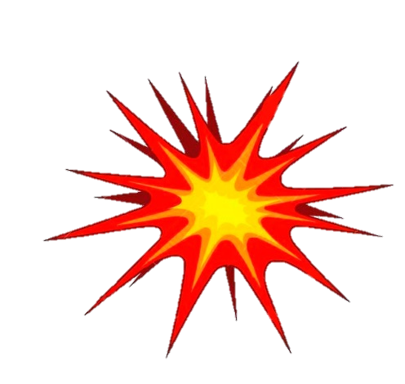
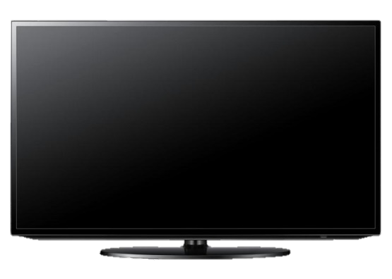

MAIN SUPPLY
ELECTRIC FUSE
An electric fuse protects circuits and appliances by stopping the flow of excess current.
Short - circuit
Domestic voltage in our house is around 220 V – 240 V
The fuses used for domestic purposes are stated as 1A,2A,3A,4A,5A,10A etc.
(very large amount of current flows)
230 V supply
High
Voltage
Wire of Lead and Tin
(Low Melting Point)
Porcelain Body

Slide 11

Q.1.
Why are coils of electric toasters and electric irons made of an alloy rather than a pure metal?
OR
Nichrome wire is used for making the heating elements of electrical appliances like iron, geyser, etc. Give reasons.
Ans. :
Coils of electric toasters and irons are made of alloys rather than pure metals because :
Resistivity of alloy is higher than pure metals.
Alloys have higher melting point, and so they don’t melt easily.
Alloys do not oxidize at high temperature and thus can be kept red-hot.

Slide 12
Q.2.
Why does the cord of an electric heater not glow while the heating element does?
Ans. :
The heating element is made of alloy which has very high resistance. So when current flows through the element, it becomes very hot and glows.
The cord is usually made of materials like copper and so has low resistance. Thus, for the same current, the cord does not becomes so hot and hence, does not glows.

Slide 13
Thank You

